Slide 1
Where Innovation Blends With Analytics
Market Basket Analysis

Slide 2

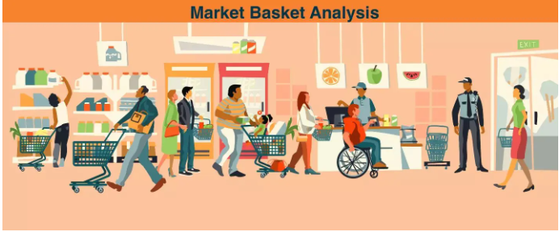
Overview
Market Basket analysis (MBA) is one such top application of machine learning in retail. Machine learning is a unique asset to the retail industry. It assists retailers in everything from predicting sales success to locating customers.
It helps retailers know which products customers buy together so that the store/website layout can be designed in the same way. This is mainly done by studying past purchase activity.
Companies also use it to cross-sell their products on their online platform. However, it is not only used in retail, but also in fraudulent insurance claims and credit card transactions.
Amazon is a great example that uses this analysis to cross-sell products. These are the products listed in the suggested items that you might be interested in along with your current purchase. Which products appear in the suggested category depends on your browsing history, other customers' purchases, and other factors.

Slide 3
How its done?
Market Basket analysis is a data mining technique that analyzes patterns of co-occurrence and determines the strength of association between commonly purchased products.
It is also known as frequent item-set mining or association analysis. It uses these patterns, which are recognized in any retail environment, to understand customer behavior by determining the relationships between the items they purchase.
In simple terms, market basket analysis helps retailers identify the products that are frequently purchased together so they can keep those items in stock at all times.
The source from which these patterns are found is the vast amount of data that is continuously collected and stored.
By mining the item set frequently, it becomes easy to discover the correlation between items in huge relational or transactional datasets. This greatly helps in decision making related to cross-marketing, catalog design, and consumer shopping behavior analysis.

Slide 4
Example for MBA
When people buy green tea, it stands to reason that they also buy honey with it. This relationship is mapped as a conditional algorithm, as shown below.
IF {green tea} THEN {honey}
This means that the items on the right are more likely to be ordered along with the items on the left. Market Basket analysis in data mining helps us understand this relationship and how helpful it would be to change our decisions based on the analysis.
Machine learning engineers develop data-driven strategies based on detailed shopping cart analytics that help retailers improve sales in the following ways.
They offer discounts on only one of the connected products.
The connected products are placed close to each other so that when the customer buys one product, he is inclined to buy the other product as well.

Slide 5
Type of MBA
Market Basket analysis includes the following types.
Descriptive market basket analysis
This type of market basket analysis provides actionable insights based on historical data. It is a commonly used approach that does not make predictions, but evaluates the association between products using statistical techniques. We also refer to it as unsupervised learning based on the way it is modeled.
2. Predictive market basket analysis
Although the terms "prediction" and "analysis" form the word "predictive analysis," it actually works the other way around. It first analyzes and then predicts what the future holds. This type of analysis uses supervised learning models such as regression and classification. It is a valuable tool for marketers, even though it is less used than descriptive basket analysis.
Predictive market basket analysis considers items purchased sequentially to evaluate cross-selling. It is mainly used in retail to identify the baskets of goods that are bought together.For example, if a consumer buys a laptop, they are more likely to also buy an extended warranty with it. So this analysis helps identify the items being considered in a sequence so they can be sold together.

Slide 6
3. Differential market basket analysis
Differential market basket analysis is an excellent tool for competitive analysis, allowing you to determine why consumers prefer to buy the same product on a particular platform, even if it is marked with the same price on both platforms.
This consumer decision is often based on several factors, which are listed below.
Delivery time
User experience
Purchase history between stores, seasons, time periods, and others.
By considering all these factors behind consumer decision, businesses can benefit from differentiated shopping cart analysis. They can align all the parameters with excellent consumer user experience and increase sales on their platform.

Slide 7
MBA Terminologies
Below are some terminologies to keep in mind when working with the market basket analysis.
Item set: refers to the set of items that are purchased by a customer at the same time. By default, we specify it as a logical rule with IF and THEN. For example: IF (bread, butter), THEN (milk). It is also possible that an item set consists of no items, which are normally ignored by all items in the dataset.
Number of supports: This is the frequency of occurrence of a particular item set in the transaction database. It is also given as a probability. For example, for milk, if 50 out of 500 possible transactions are supported, the probability is 50/500 or 0.1.
Confidence: Refers to the conditional probability that indicates which items are likely to be purchased together. It finds application in product placement strategy aimed at increasing profitability. For example, by placing high margin items near high confidence items, retailers can increase overall sales and revenue from purchases.
Antecedent: The component IF, which is on the left, or the item records in the data are called antecedents.
Consequence: the component THEN or an item or item set found in combination with the antecedent is called a consequence.

Slide 8
MBA Algorithms
Market Basket analysis uses the association rule { IF } - > { THEN } to predict the probability that certain products will be purchased together. They count the frequency of co-occurrence of items and look for associations that occur more often than expected.
Some algorithms that take advantage of these association rules are AIS, Apriori, and SETM.
Apriori is the most commonly cited algorithm by data scientists that identifies frequent items in the database. It is suitable for unsupervised learning and requires no training and thus no predictions. This algorithm is mainly used for large datasets where useful relationships between elements should be identified.
All elements in a frequent element set must also be frequent. This can save a lot of computation time.
The Apriori algorithm works in two steps, which are explained below.
It systematically identifies the itemsets that are frequent in the data set and whose support is greater than the given threshold.
Then, it calculates the confidence of all possible rules. However, it retains only the item sets whose confidence is greater than a given threshold.

Slide 9
It is further divided into three components.
Support
Confidence
Lift
Let us assume that a popular eCommerce website does 100 transactions. Now, if we want to calculate Lift, Support, and Confidence for two products, e.g., books and pencils, we proceed as follows.
Suppose there are 10 transactions for books and 8 transactions for pencils and 6 transactions are made for both products.
1. Support: this is the total number of transactions for a given product divided by the total number of transactions made. Zero means no support, while one represents the highest support. The higher the value of support, the greater the importance of the item set in the data.
Support (books) = Freq (books)/Total transactions
Support (books) = 6/100 = 0.06%
2. Confidence: This is the ratio of combined transactions to individual transactions.
Confidence (books) = Combined transactions/individual transaction

Slide 10
Confidence (Books) = 0.06/0.08 = 0.75
3. Lift: It is the ratio between the confidence rate and the support rate.
Lift = 0.75/0.10 = 7.5
If the value of Lift is < 1, the combination is not frequently purchased by consumers.
If the value of Lift >is 1, the combination is frequently purchased by consumers.
If the value of Lift = 1, then the purchase of the predecessor does not affect the successor.
The basket analysis is used to look for the rules that lead to a Lift value greater than 1.
Note: Confidence and support can be used to influence the Apriori algorithm. This is done by specifying threshold values to search for. For example, if we set a minimum support value of 0.5 and a confidence value of 0.65, we instruct the computer to report only those association rules that are above these thresholds. In this way, we eliminate useless tools that do not add value to the decision process.

Slide 11
MBA Advantage
For retailers: Market basket analysis (MBA) is highly beneficial for the marketing perspective of retailers. It helps retailers optimize their marketing campaigns and strategically plan future sales by better understanding their customers. Offering actionable customer patterns and behaviors helps to increase store sales and increases ROI. It also increases customer loyalty and improves the customer experience while shopping in a store.
Personalized recommendations: Market basket analytics identifies the genre of movies a person likes to watch and recommends movies on OTT platforms such as Amazon Prime and Netflix.
Promotions and campaigns: This analysis helps understand the products that go together with the products that form the cornerstones of the product line.
Customer behavior analysis: Market basket analysis helps you understand customer behavior used from UX /UI design to catalog design.
Optimizing store operations: The MBA has great application in optimizing inventory by determining the popularity of products in a store.
New marketing tactics: MBA facilitates the task of discovering new marketing strategies to grow a brand. It analyzes demographic and gentrification data to help you make informed decisions about where to open your next store or place ads.

Slide 12
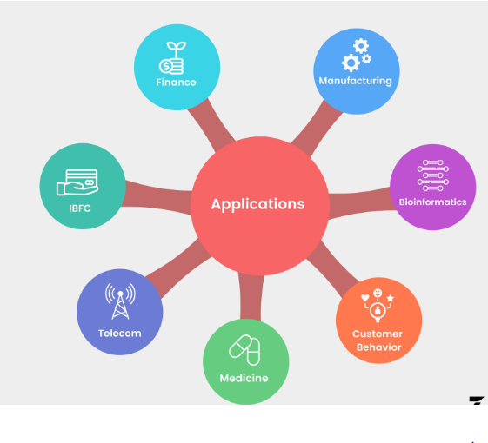
MBA Applications
Finance/Criminology: Market basket analysis has great application in detecting fraud related to credit card usage data.
Manufacturing: Predictive market basket analysis helps in predicting equipment failure.
Bioinformatics/Pharmacy: Market Basket analysis helps in discovering correlations between pharmaceutical agents and diagnoses prescribed to different patient populations.
Customer behavior: Using socioeconomic and demographic data, shopping cart analysis helps determine associated purchases.
Medical: Market basket analysis finds great use in determining symptom analysis and comorbid conditions in the medical field. It also helps in identifying hereditary traits and genes associated with local environmental influences.

Slide 13
6. Telecommunications: increasing attention to customer service by telecommunications companies is facilitated by market basket analysis. For example, telecom companies have begun offering TV and Internet packages along with other discounted online services to avoid churn.
7. IBFS: The IBFS organization uses market basket analytics to track a consumer's credit card history. Based on the data obtained, these companies entice potential customers with attractive discounts by deploying sales experts in shopping malls.

Slide 14
Thank you

